Slide 1



ISMM 22
Reconsidering OS Memory Optimizations in the Presence of Disaggregated Memory
Shai Bergman, Priyank Faldu, Boris Grot, Lluís Vilanova, Mark Silberstein
Notes:
Hello everyone…
This is joint work between the ACSL lab in the Technion, Imperial College London, and the University of Edinburgh
I’m going to talk about our paper, Reconsidering OS Memory Optimizations in the Presen…

Slide 2

Increasing Memory Requirements
Data center applications exhibit large memory footprint
Overprovisioning memory is common practice
Notes:
Over time, the demand for additional memory in servers increases
Data-center applications exhibit larger and larger memory footprints

Slide 3

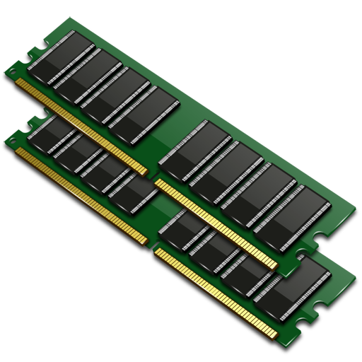
Increasing Memory Requirements
Memory is one of the leading contributors of overall data center expenses
  Up to 40%
Increasing DRAM on a single machine sometimes isn’t feasible
  Limited DIMM slots
  Limited CPU pins
=
Notes:
Well, RAM is expensive, and is one of the leading contributors of overall data center expenses
However, there is a limit on how much RAM a single machine accommodate, due to limited DIMM slots and CPU pins.
Further, DIMM costs increase exponentially as its density increases

Slide 4
Background: Disaggregated Memory
Disaggregated Memory:
High memory capacity at a rack scale
Memory consolidation between nodes:
    Less over-provisioning
    Overcomes local HW limitations
    Independently scalable
Notes:
One approach to address this problem is by disaggregating the memory from the compute blades
Instead of co-locating CPUs with large amounts of memory in a single blade, a disaggregated memory system introduces a memory blade
A memory blade has memory modules and is connected to the compute blades via an interconnect.
Each compute blade has a small local DRAM memory, and has access to the remote memory blade
Memory disaggregation enables to lower over-provisioning, and independently scale memory and compute

Slide 5

Background: Disaggregated Memory
Notes:
Well, as we all know
CLICK
there are no free lunches.

Slide 6
Background: Disaggregated Memory
Disaggregated Memory:
Higher access latency (interconnect + (switch?) + memory technology)
In this work we take a top-down approach, examining:
How can disaggregated memory be utilized efficiently?
Notes:
A drawback disaggregated memory is higher latency of accessing the memory blade.
In the diagram below we can see a continuum of access latencies to different memory technologies.
Typical local access to DRAM has an access latency of around 70ns, persistent memory such as optane has around 300ns.
Disaggregated memory however has a higher latency, expected to range between 750ns and 1.5us with today’s technologies.
As I will demonstrate in this presentation, when the remote memory access latency is in the disaggregated memory range, certain system trade-offs change which require a re-examination of typical memory subsystem optimizations
CLICK
So in this work, we take a top-down approach in identifying and addressing these challenges, and introduce HotBox, our memory management subsystem for disaggregated memory systems

Slide 7




Disaggregated Memory- Challenges
Memory Access Model:
Cache-line only vs. swap vs. hybrid
Disaggregated Memory Latency Regime Changes System Trade-offs:
Typical Page Management Optimizations Break:
Huge pages are ineffective
Batching pages for migrations is ineffective
Relative Page Utility Matters Most:
Accurate page hotness detection with low overheads
Efficient remote memory range hotness inspection
Notes:
Some of the challenges we address are as follows:
CLICK
We first need to consider how we wish to access the disaggregated memory blade. Prior works have treated the blade either as a swap device, directly accessible memory, or as a hybrid design between the two models.
CLICK
Second, we observe that under the disaggregated memory latency regime, certain system trade-offs change
CLICK
In particular, we note that typical page managements optimizations break, such as huge pages, and batching pages for migration
CLICK
Further, we show that in a disaggregated system, the identification of which pages are hot matters most to performance. But the identification process itself resource-intensive

Slide 8
Disaggregated Memory- Challenges
Memory Access Model:
Cache-line only vs. swap vs. hybrid
Disaggregated Memory Latency Regime Changes System Trade-offs:
Typical Page Management Optimizations Break:
Huge pages are ineffective
Batching pages for migrations is ineffective
Relative Page Utility Matters Most:
Accurate page hotness detection with low overheads
Efficient remote memory range hotness inspection
Notes:
In this talk I will focus on three of the challenges listed:
First I will address which model we chose for best performance in a disaggregated memory system.
Next, we show that huge pages are ineffective in a disaggregated memory system,
Finally, I will address the issue of measuring page’s hotness with low overheads

Slide 9
Challenge 1: Memory Access Model
Access Granularity
We utilize the Hybrid Model: (we demonstrate its superiority in the paper)
Cache-line accesses to remote memory
Page migration between local and remote memory
Model utilized in prior works*
*Nimble Page Management for Tiered Memory Systems
Thermostat: Application-transparent Page Management for Two-tiered Main Memory
Notes:
In this work we utilize the hybrid access model, which combines remote cache line accesses with page migrations. Further information and analysis is available in the paper which led us to choose this model.
In a hybrid access model model, every compute node has a small local memory, and access to large remote memory. Both types of memory are directly addressable, but accesses to the remote memory incur high latency costs
Pages identified as hot in the disaggregated memory blade are migrated to the small local memory, and cold pages are migrated from the local memory to remote
The choice of which pages are migrated are up to the OS memory subsystem’s policy

Slide 10
Challenge 2: Huge Pages
Huge pages in traditional systems:
Shorten access latency:
Extend TLB reach
Shorten TLB-miss induced page walk
Access Granularity
Are huge page benefits still apparent in a disaggregated memory system?
Notes:
In our work we re-examine the benefits of huge pages.
In a traditional system, huge pages help reduce the translation costs incurred upon TLB miss. They also increase the overall TLB reach
CLICK
We ask whether huge pages are beneficial in a disaggregated memory system.

Slide 11
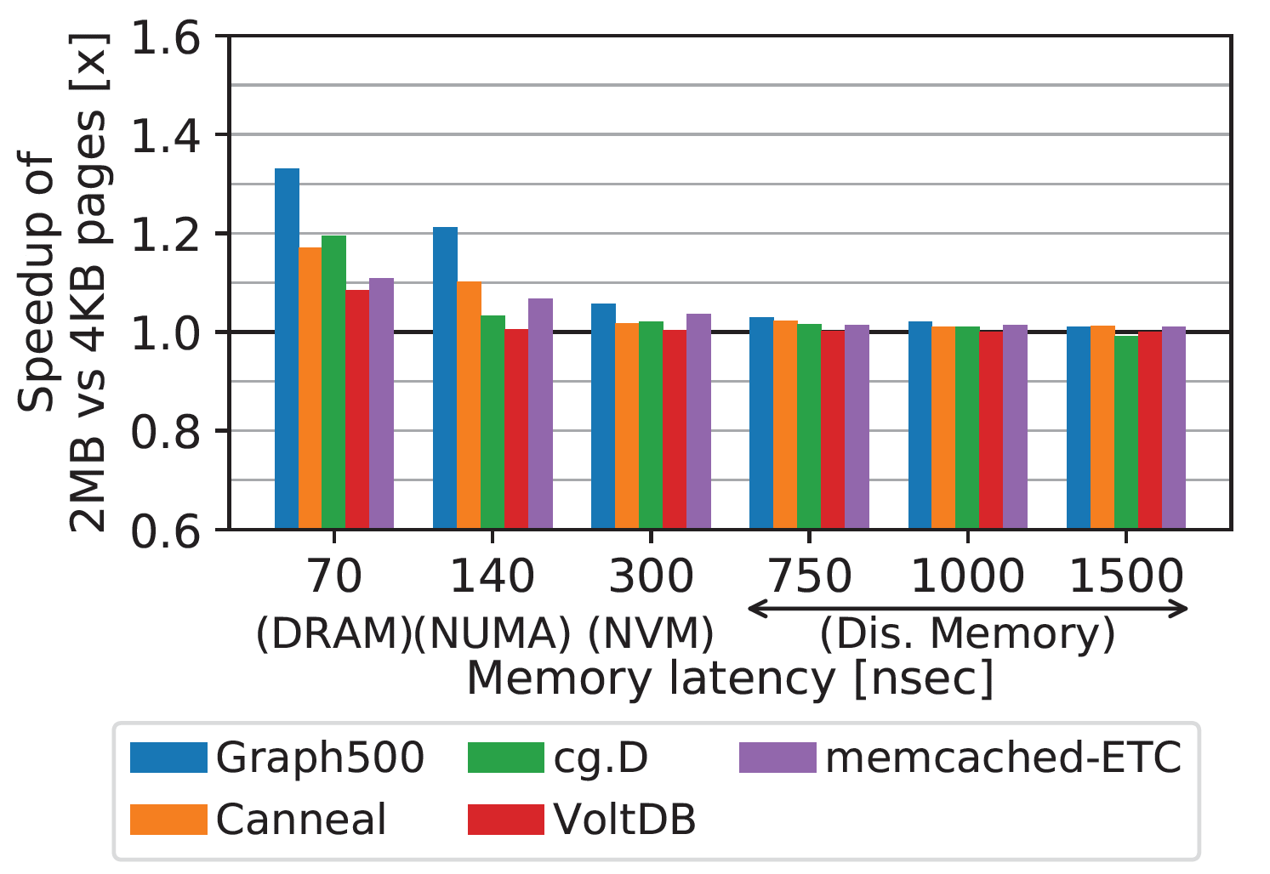
Huge Pages in Remote Memory
Access Granularity
Performance gains diminish
Notes:
We evaluate the impact huge pages have on system performance by evaluating huge-page-friendly workloads
We execute each workload with base and huge pages, and place all page tables in local memory, and the rest in remote memory, which has a higher latency than local memory.
The Y axis of the graph depicts the speedups gained by using huge pages over base pages, and the X axis is the access latency to the memory
At the small end of the latency spectrum, for example local DRAM access, and NUMA accesses, all workloads exhibit speedups. This makes sense as huge page support for operating systems are designed for these latency regeims.
As we increase the remote memory access latency, the benefits of huge pages start to diminish.
CLICK
Specifically, the benefits of huge pages under the disaggregated memory latencies diminish altogether
As the access latencies increase, the relative overhead spent on address translation decreases, therefore the benefits of huge pages are not apparent

Slide 12
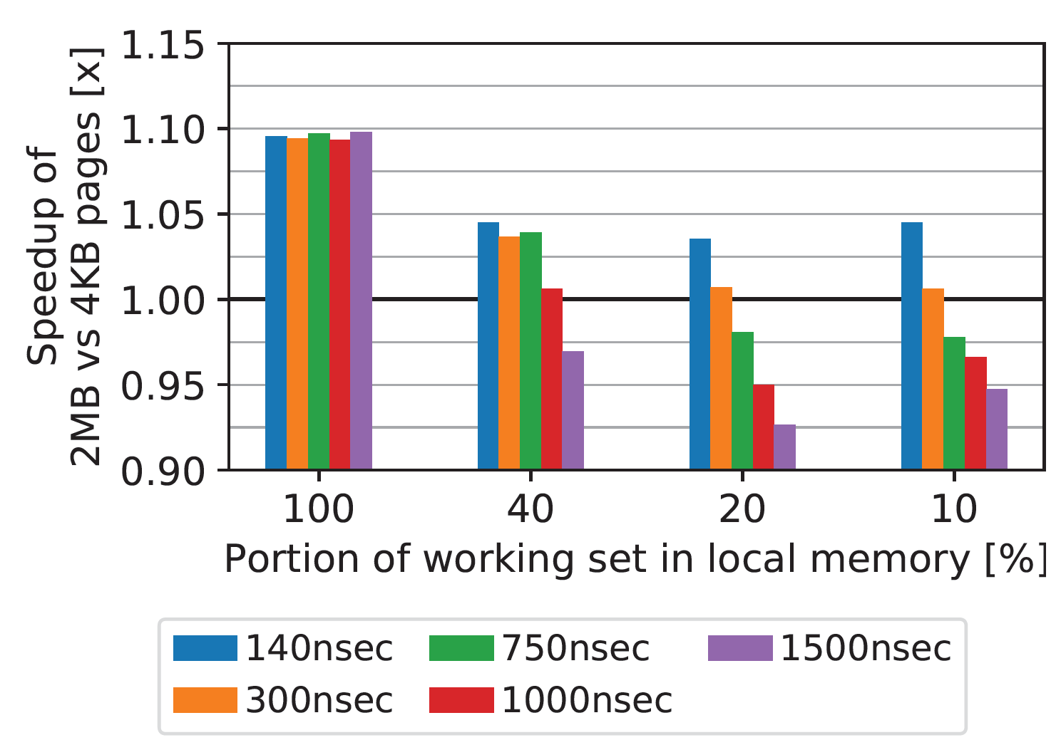
Huge Pages in Local Memory
Access Granularity
Negative impact as latency increases
What went wrong:
Memory bloat?
Coarse-grained
information?
“Hot” huge pages contain “cold” base pages
Notes:
To evaluate the impact of huge pages in local memory in a disaggregated memory system, we execute Memcached serving Facebook’s ETC workload
As before, the Y axis depicts the speedup of huge page execution vs. base page on local memory. The X axis is the portion of the workingset which fits in local memory.
We place the hottest pages in local memory via prior offline analysis
As the portion of the workingset in local memory decreases, so does the speedup of huge pages.
CLICK
At a certain point, we notice a slowdown of the huge page execution vs base pages.
CLICK
As there is a slowdown and the performance didn’t normalize to base pages performance only, we investigated further.
whether this is caused by memory bloat
CLICK
Which turned out was not the case
We also asked ourselves whether the coarse-granular information of huge pages affected the placement policy
CLICK
But we statically place the hottest pages in local memory and do not migrate memory over time
Turns out that this slowdown occurs because the hot huge pages that reside in local memory contain cold base pages, which occupy valuable local memory space

Slide 13
Hotness Fragmentation
Hotness fragmentation:
Spatial locality of accesses to huge pages tend to be low
Huge pages in local memory underutilize precious low-latency memory
Example: Local memory size == 2MiB. Hot 4KiB pages ==512:
Access Granularity
More details about Hotness fragmentation in the paper
Best case scenario:
High huge-page spatial locality
Typical scenario:
25% of hot pages in remote memory
Notes:
We call the phenomenon observed in the previous graph “hotness fragmentation”
Hotness fragmentation occurs when cold base pages reside within local huge pages. These huge pages are placed in local memory due to their overall hotness.
This phenomenon directly affects performance.
As a toy example, lets assume a disaggregated memory system with a local memory of 2MiB, the size of a huge page.
Our toy workload has 512 base pages’ worth of hot data, each 4KiB in size.
When huge pages are enabled in local memory, the best-case scenario is if all the base pages are part of the same huge-page, which is placed in local memory
CLICK
However, in a typical scenario, these pages are not contiguous in the virtual address range and cannot be co-located together in the same huge page. This leads to the under-utilization of local memory
In the disaggregated memory latency regime, placing hot pages in remote memory has a high penalty. Consequently, it is more efficient to have slightly worse translation performance to local memory than paying high penalties for remote accesses
CLICK
More information regarding hotness fragmentation can be found in the paper

Slide 14
Challenge 3: Accurate Page Hotness Detection with Low Overheads
Hotness detection is based on page table accessed bit scanning
Base pages provide finer granularity hotness information
  But also increase the number of elements to scan
Scanning accessed bits has high overheads:
  High scanning frequency will introduce too much overhead
  Slow scanning frequency will not differentiate between hot and cold pages
Notes:
In order to classify pages as either hot or cold, we utilize accessed bits in the page tables.
Base pages provide finer hotness classification granularity, but the number of page table entries which represent a virtual address range is far larger than a huge-page based system. This means that more system resources need to be spent when scanning a virtual address range backed by base pages vs. huge pages.
Also, the accessed bit scanning frequency needs to be high enough to differentiate between hot and cold pages. However this entails high overheads
If the scanning frequency is too low, all pages in the system will be classified as hot

Slide 15
HotBox: Design and Core Ideas
Memory Access Model:
-> hybrid
NUMA 0
NUMA 1
Treat local and remote memory as separate NUMA nodes
Disaggregated Memory Latency Regime Changes System Trade-offs:
Typical Page Management Optimizations Break:
Huge pages are ineffective
Batching pages for migrations is ineffective
-> Utilize base pages
-> On-demand migration
Relative Page Utility Matters Most:
Accurate page hotness detection with low overheads
Efficient remote memory range hotness inspection
-> Adaptive scanning
and migration utility
inspection
-> Hierarchal Page table
scanning
Notes:
At this point we introduce HotBox, a low-over OS memory subsystem for disaggregated memory systems.
Addressing the prior challenges introduced:
CLICK
HotBox utilizes the hybrid memory access model to achieve high performance
CLICK
and uses the NUMA abstraction for local and remote memories
CLICK
HotBox uses base-pages only to circumvent hotness fragmentation, as well as gain fine-granular information on memory hotness
CLICK
And finally, Hotbox employs an adaptive scanning and migration utility inspection to accurately classify page hotness, and do so with low overheads. In the disaggregated memory latency regime, penalties for mis-identification of hot pages are high. it is important to correctly classify pages in both local and remote memory. In the next slides we will go over the adaptive scanning and migration utility mechanisms

Slide 16
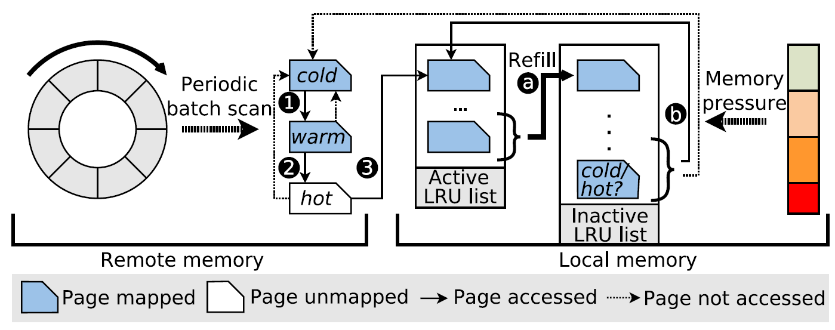
Adaptive Scanning
HotBox utilizes a closed feedback loop for scanning local memory:
Lowers unnecessary local memory high-frequency scanning overheads
Notes:
HotBox utilizes an adaptive scanning technique akin to Linux’ page frame reclaim mechanism to differentiate between hot and cold pages, as well as to keep scanning overheads low
The diagram represents the migration and scanning mechanism employed by HotBox.
On the right we can see the active and inactive LRU lists for local memory.
The left side of the diagram represents the remote memory and HotBox’s classification technique for remote memory pages.
Hotbox periodically scans pages which reside in the remote memory and updates their state between cold, warm and hot

Slide 17
Adaptive Scanning
HotBox utilizes a closed feedback loop for scanning local memory:
Lowers unnecessary local memory high-frequency scanning overheads
Notes:
Once a page is classified as hot in the remote memory, it is unmapped from the page tables

Slide 18
Adaptive Scanning
HotBox utilizes a closed feedback loop for scanning local memory:
Lowers unnecessary local memory high-frequency scanning overheads
Notes:
Upon a subsequent access to the unmapped page, a page fault is raised, and the page is migrated to local memory and inserted into the active list
This in turn increases the local memory pressure

Slide 19
Adaptive Scanning
HotBox utilizes a closed feedback loop for scanning local memory:
Lowers unnecessary local memory high-frequency scanning overheads
Notes:
Once the local memory pressure is raised, the active and inactive lists are shrinked, and the pages at the bottom of the inactive list are examined and classified as either hot or cold
The adaptivity of the local memory scanning relies upon the presence of hot pages in the remote memory.
If few hot pages are detected in remote memory, local memory scanning frequency is low and vice versa.
However, once the hot pages, or the hottest subset of them, reside within local memory, any further scanning and migration efforts are fruiteless and will only hurt performance by exerting overheads on the system

Slide 20

Migration Utility Inspection
Lowering remote memory scanning overheads and reduce thrashing:
Avoid scanning and migrating pages when the operation’s utility is low:
Linux Kernel
HotBox Utility Monitor
HotBox Scanning Mechanism
HotBox Migration Mechanism
PMU
LLC misses to local mem
LLC misses to remote mem
Notes:
To control the remote memory scanning and the overall migration mechanism, HotBox employs a migration utility inspection technique
The HotBox utility monitor utilizes the CPU’s performance counters, specifically the number of LLC misses to local and remote memory, to determine the utility of memory migrations

Slide 21


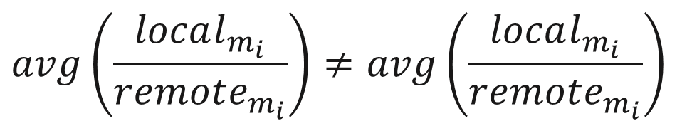
Migration Utility Inspection
Lowering remote memory scanning overheads and reduce thrashing:
Avoid scanning and migrating pages when the operation’s utility is low:
Linux Kernel
When migrations seem effective, or the executing application is “changing phase”
HotBox Utility Monitor
Resume
HotBox Scanning Mechanism
HotBox Migration Mechanism
Local vs. Remote
miss ratio is changing
$$avg\left(\frac{local_{m_{i}}}{remote_{m_{i}}}\right)≠avg\left(\frac{local_{m_{i}}}{remote_{m_{i}}}\right)$$
PMU
LLC misses to local mem
$$i∈[t−\left(m+n\right), t−m]$$
$$i∈[t−m, t]$$
LLC misses to remote mem
Notes:
The utility monitor inspects the local vs. remote memory miss ratios.
If the local memory hit rate is not constant, either the migration mechanism is affecting the local memory hit ratio, or the application itself is changing phases, for example, utilizing a new dataset

Slide 22


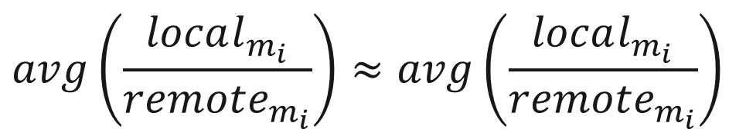
Migration Utility Inspection
Lowering remote memory scanning overheads and reduce thrashing:
Avoid scanning and migrating pages when the operation’s utility is low:
Linux Kernel
When migrations seem ineffective on the local memory hit rate
HotBox Utility Monitor
Pause
HotBox Scanning Mechanism
HotBox Migration Mechanism
$$avg\left(\frac{local_{m_{i}}}{remote_{m_{i}}}\right)≈avg\left(\frac{local_{m_{i}}}{remote_{m_{i}}}\right)$$
Local vs. Remote
miss ratio is constant
$$i∈[t−\left(m+n\right), t−m]$$
$$i∈[t−m, t]$$
PMU
LLC misses to local mem
LLC misses to remote mem
Notes:
Once the local hit ratio remains relatively constant, the migrations performed by HotBox do not have an effect on the local memory hit rate
The utility monitor pauses the migration and scanning mechanisms to avoid scanning overheads and ineffective memory migrations
At this point, the system is essentially thrashing without performance gains from the migration operations
The utility monitor continues to inspect the LLC miss counters to detect any change in the state, and resume migrations if necessary

Slide 23
Evaluation
Performed on Intel’s PMEP platform:
Configurable remote memory access latency
Evaluated Systems:
All-remote (cache-line accesses to remote memory)
Swap (optimized swap w/o block layer)
Nimble-base (current state of the art hybrid disaggregated memory system)
Nimble-huge (Nimble with huge pages)
HotBox w/o adaptive throttling
HotBox
Notes:
We conduct our evaluation on Intel’s PMEP hardware emulation platform that enables to configure an arbitrary access latency to a remote memory node
We evaluate a system where all memory apart from the page tables reside in the remote memory node. This serves as our lower bound on performance
We also evaluate a swap-based system that is optimized to not go via the block layer for additional performance. This is similar to fastswap from prior work.
Nimble is the current state of the art hybrid disaggregated memory system. We evaluate both Nimble with and without huge pages
Finally we evaluate HotBox, with and without the adaptive throttling mechanism

Slide 24
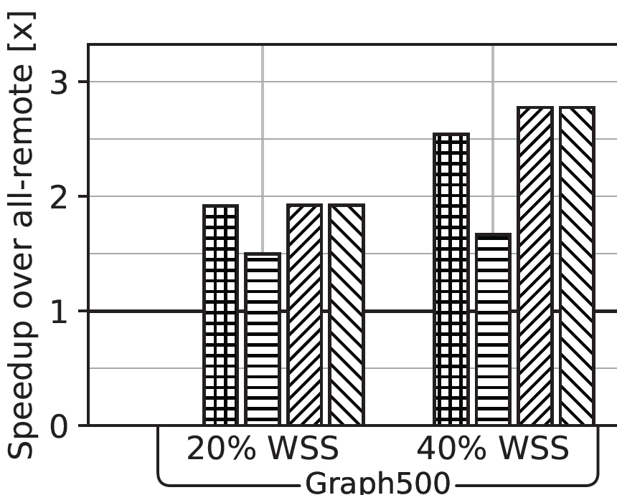
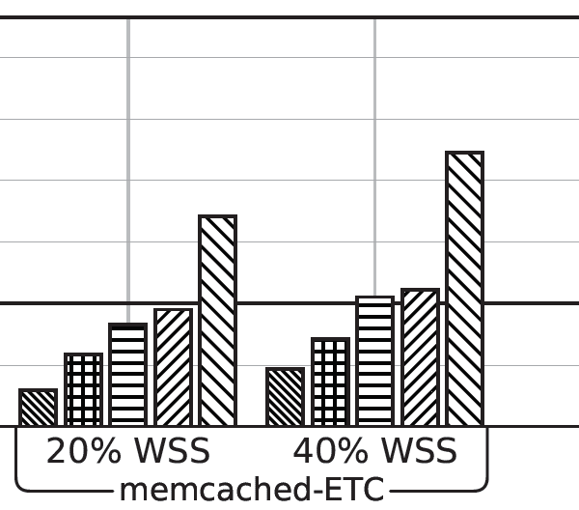
Evaluation of core ideas
Hotness Fragmentation
Adaptive
throttling
Notes:
In this graph we compare the performance of the systems on two workloads, graph500 and Memcached serving facebook’s ETC request pattern with the mutilate client
The Y axis shows the speedup of the systems vs. the all remote configuration, higher is better. The X axis has the workloads, the local memory size relative to the working set size, and finally the different systems we have evaluated
We can see that HotBox outperforms the other systems.
CLICK
Specifically, we see the effects of the adaptive throttling mechanism in Memcached. Memcached has a static skew that doesn’t change over time. Once the hot pages are identified and placed in local memory, the adaptive scanning mechanism pauses migrations, lowering scanning and migration overheads
CLICK
If we compare Nimble with huge pages vs. base pages on Graph500, we observe that nimble with base pages performs better than with huge pages.
This is essentially the effect of hotness fragmentation in Graph500 workload

Slide 25
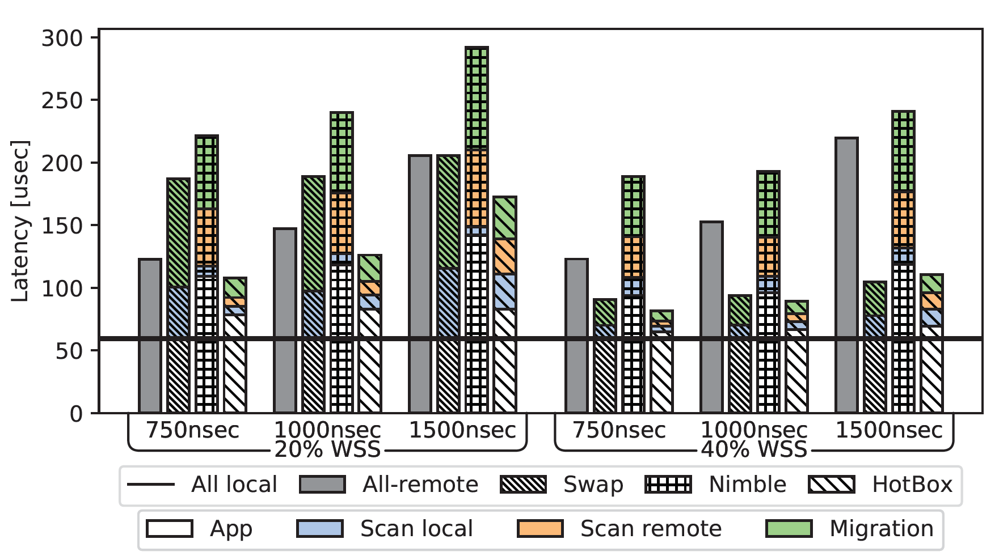
Evaluation of Migration Decisions & Overheads
Notes:
Next we evaluate VoltDB TPCC for all systems
In this graph, the Y axis is the mean latency per request, the lower the better
The X axis depicts the local memory size as a portion of the working set, and different remote memory access latencies. Finally, each cluster of bars for a certain latency is the performance of all the evaluated systems. HotBox is on the right of each cluster of bars.
The colors in the breakdown show the contribution of the overheads of each mechanism to the mean latency
HotBox’s overheads are substantially lower than the other systems.
CLICK
Specifically, if we examine the non-colored portion of the bar, which is the actual application time, we can see that it is close to that native execution time. This demonstrates that HotBox performs good migration decisions and places the hottest pages in local memory.

Slide 26

Conclusions
Disaggregated memory introduces additional considerations to OS design:
  Typical page management optimizations break
      Huge pages not beneficial
  Relative page utility matters most
  HotBox: Linux memory management subsystem for disaggregated memory
  Top-down driven design for efficiency and low-overheads
Thank you!
Questions?
shaiberg1@tx.technion.ac.il
Notes:
In this presentation we saw that disaggregated memory changes system design considerations which require a reexamination of well known memory optimizations
Specifically we show that huge pages actually hurt system performance
We also introduced HotBox, a low overhead memory subsystem for disaggregated memory

Slide 27
Background: Tiered Memory
Memory Tiering:
High-capacity memory at lower cost
Lower per-byte cost
Higher latency

Slide 28
Analysis: Access Granularity
Disaggregated memory system models:
Access Granularity
Swap
Disaggregated memory utilized as a swap device:
Data can only be accessed directly from local memory
Remote memory access triggers a swap-in operation
Cold pages are swapped out
Cache-line
Hybrid

Slide 29
Analysis: Access Granularity
Disaggregated memory system models:
Access Granularity
Swap
CPU accesses data directly from disaggregated memory:
Byte-addressable remote memory
Regular LD/ST operations
Data operations at cache-line granularity
Cache-line
Hybrid

Slide 30
Analysis: Access Granularity
Disaggregated memory system models:
Access Granularity
Swap
Combines the prior approaches:
Migrate “Hot” data to local memory and “Cold” data remote memory
Adds a new dimension of freedom
Cache-line
Hybrid

Slide 31
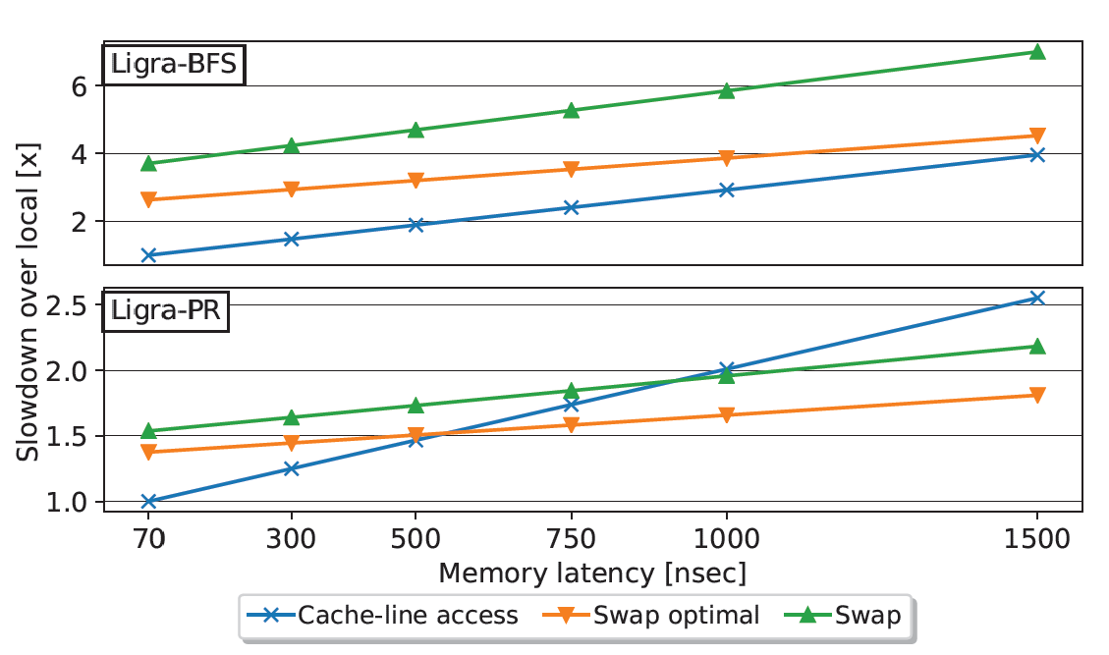
Analysis: Access Granularity
Disaggregated memory system models:
Neither Swap or Cache-line models are strictly superior
A Hybrid approach is required
Access Granularity

Slide 32
HotBox: Analysis - Memory Management Granularity
Huge pages in local memory – case study: memcached
What went wrong:
Memory bloat?
Coarse-grained information?
Access Granularity
No memory bloat observed
Static placement policy

Slide 33

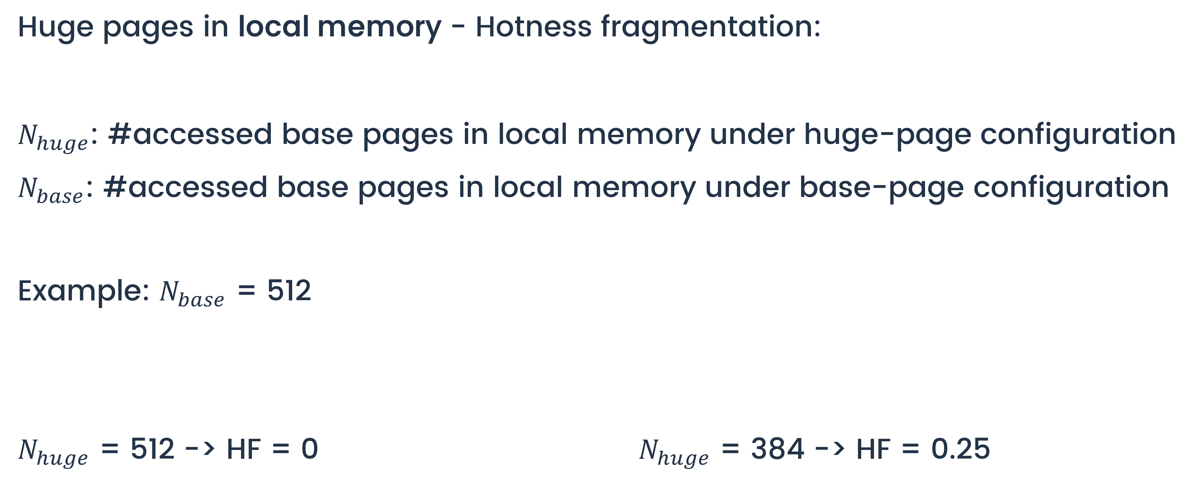
Analysis: Memory Management Granularity
Huge pages in local memory - Hotness fragmentation:
$N_{huge}$: #accessed base pages in local memory under huge-page configuration
$N_{base}$: #accessed base pages in local memory under base-page configuration
Example: $N_{base}$ = 512
$N_{huge}$ = 512 -> HF = 0 $N_{huge}$ = 384 -> HF = 0.25
Access Granularity

Slide 34
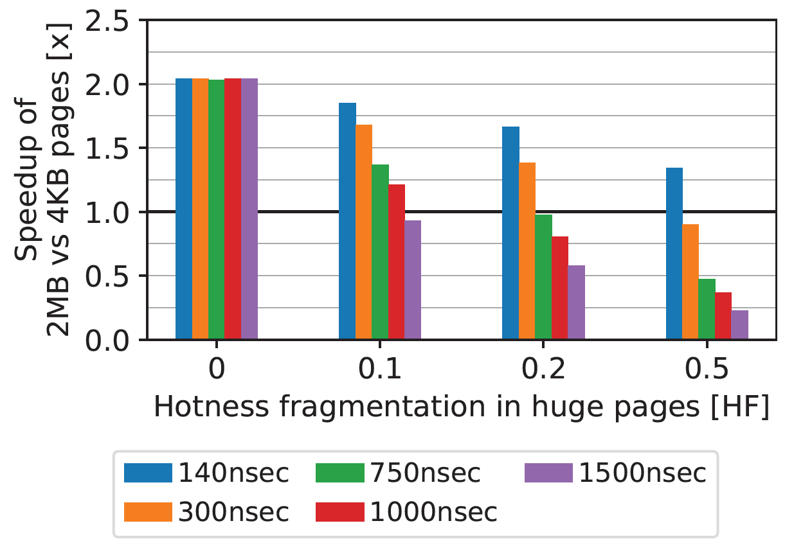
Analysis: Memory Management Granularity
Huge pages in local memory - Hotness fragmentation:
Performance impact – tradeoff between HF and huge-page 100% TLB hit
Access Granularity

Slide 35
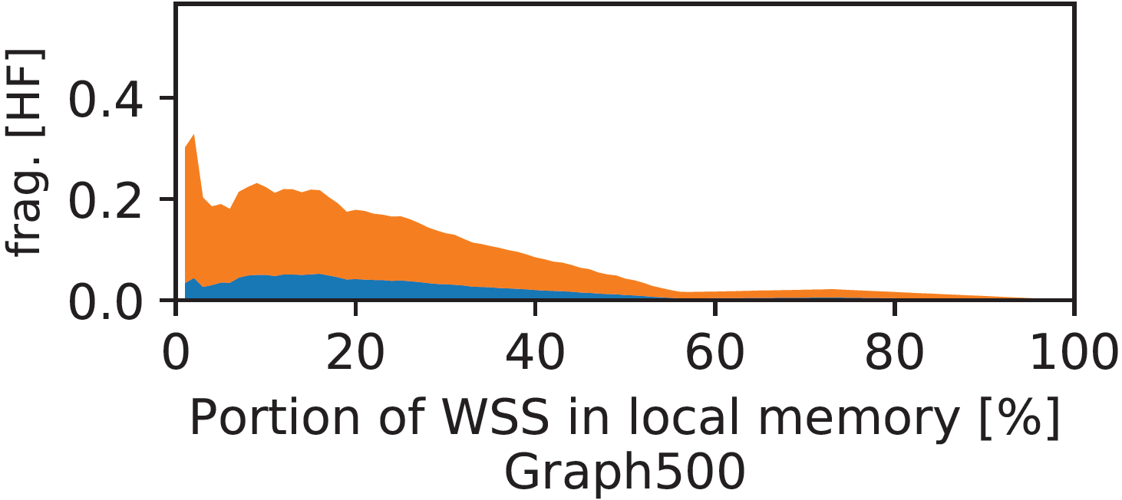
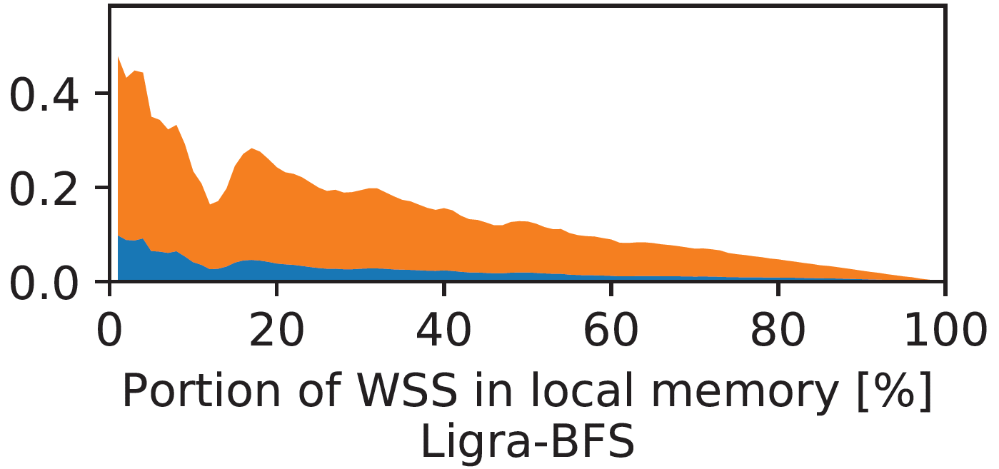
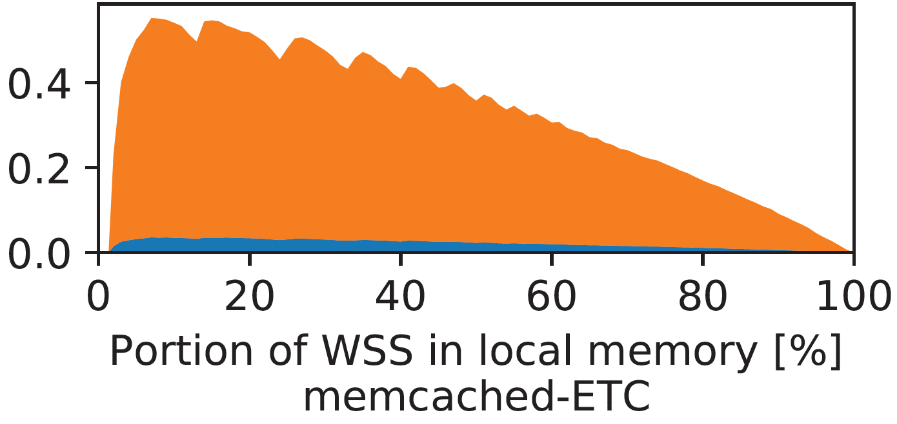
Analysis: Memory Management Granularity
Huge pages in local memory - Hotness fragmentation:
Hotness Fragmentation is apparent in server workloads:
Access Granularity

Slide 36
Analysis: Migration Timeliness and Granularity
In a hybrid disaggregated memory system:
Hot pages are migrated to local memory
Cold pages are migrated to remote memory
After remote page(s) are determined as hot:
    At what granularity should data be migrated?
    When should the data be migrated?
Access Granularity

Slide 37
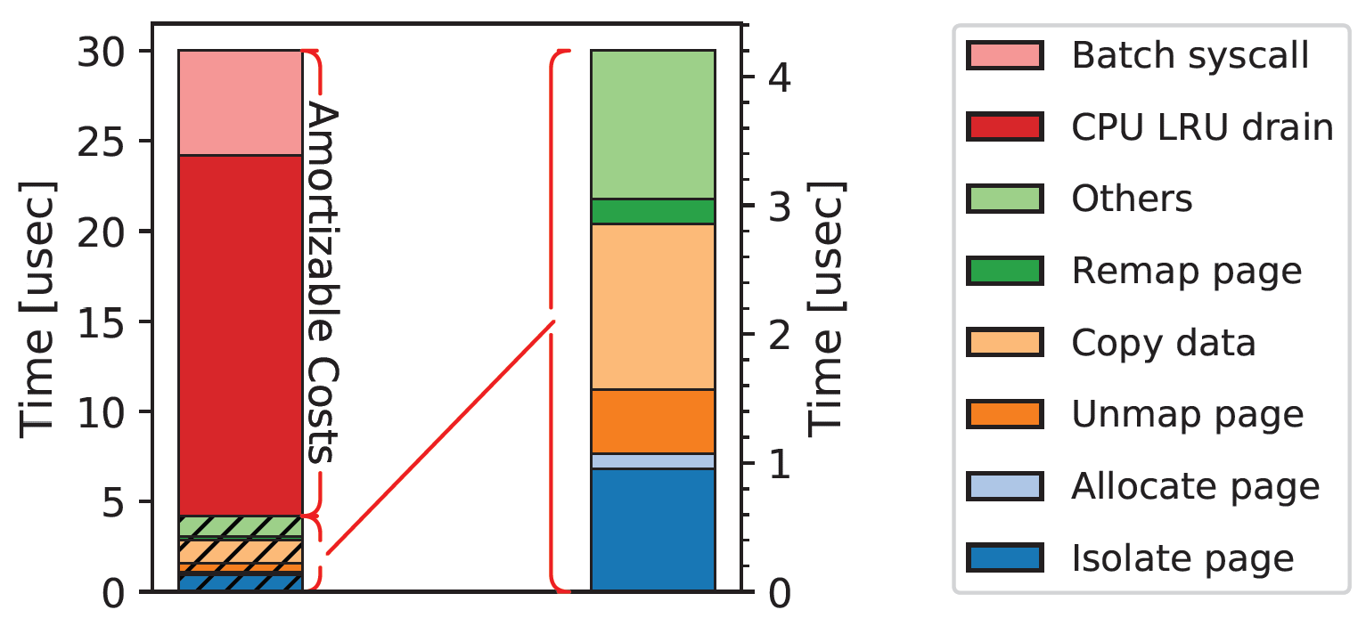
Analysis: Migration Timeliness and Granularity
Prior work advocated to migrate pages in batches to amortize migration costs
Access Granularity
IPI and syscall overheads are amortizable
However, they can be entirely avoided:
Linux’ autoNuma does not perform IPI
A breakdown of the costs to migrate a page via syscall

Slide 38
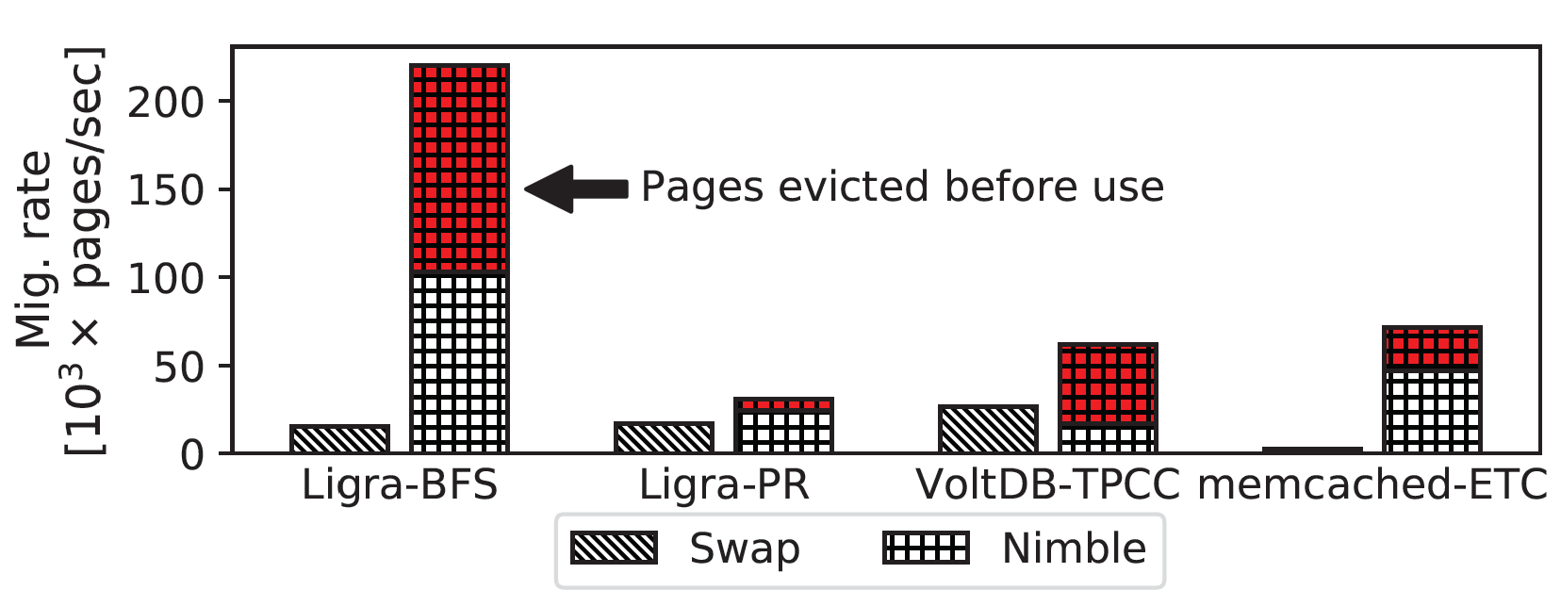
Analysis: Migration Timeliness and Granularity
Prior work advocated to migrate pages in batches to amortize migration costs
Batching delays page migration from the time of detection
Batching prefetches data in batches in anticipation it will be accessed
Access Granularity
Notes:
Link everything to the latency range!!
Because we bring in useless crap, the penalty for remote accesses are high

Slide 39
Agenda:
Background
Analysis:
    Access Granularity
    Memory Management Granularity
    Memory Migration Timeliness & Granularity
HotBox
    Design & Implementation
    Evaluation

Slide 40
HotBox: Design and Implementation
Differentiating Hot and Cold pages in local memory
HotBox utilizes accessed bit scanning:
Fast sampling frequency
0
0
  High accuracy in hotness detection between frequently accessed pages
  High CPU overheads
0
Pages’ accessed
bits
0
0
0

Slide 41
HotBox: Design and Implementation
Differentiating Hot and Cold pages in local memory
HotBox utilizes accessed bit scanning:
Slow sampling frequency
0
  Low accuracy in hotness detection
  Low CPU overheads
1
1
1
1
1

Slide 42
HotBox: Design and Implementation
Differentiating Hot and Cold pages in local memory
HotBox utilizes accessed bit scanning:
Slow sampling frequency
1
  Low accuracy in hotness detection
  Low CPU overheads
0
1
1
1
1

Slide 43
HotBox: Design and Implementation
Differentiating Hot and Cold pages in local memory
HotBox utilizes accessed bit scanning:
Slow sampling frequency
1
  Low accuracy in hotness detection
  Low CPU overheads
1
0
0
1
1

Slide 44
HotBox: Design and Implementation
Lowering remote memory scanning overheads:
HotBox scans the virtual address ranges of applications in remote memory:
Avoid costly reverse-mapping operations
Utilize hierarchal page-table accessed-bit scanning technique
PGD
PUD
PMD
PTE

Slide 45
HotBox: Design and Implementation
Lowering remote memory scanning overheads:
HotBox scans the virtual address ranges of applications:
Avoid costly reverse-mapping operations
Utilize hierarchal page-table accessed-bit scanning technique
PGD
PUD
PMD
PTE

Slide 46
HotBox: Design and Implementation
Lowering remote memory scanning overheads:
HotBox scans the virtual address ranges of applications:
Avoid costly reverse-mapping operations
Utilize hierarchal page-table accessed-bit scanning technique
PGD
PUD
PMD
PTE

Slide 47
HotBox: Design and Implementation
Lowering remote memory scanning overheads:
HotBox scans the virtual address ranges of applications:
Avoid costly reverse-mapping operations
Utilize hierarchal page-table accessed-bit scanning technique
PGD
PUD
PMD
PTE

Slide 48
HotBox: Design and Implementation
Lowering remote memory scanning overheads:
HotBox scans the virtual address ranges of applications:
Avoid costly reverse-mapping operations
Utilize hierarchal page-table accessed-bit scanning technique
PGD
PUD
PMD
PTE

Slide 49

HotBox: Design and Implementation
High-performance, low overhead disaggregated memory subsystem
Design choices:
Access Model/Granularity
Hybrid design
Memory Management Granularity
Base pages
Memory Migration Timeliness & Granularity
On-demand
Complexity

